Slide 1
Course Code: BMGT 220/ ECON 222
Course Name: Business Statistics 2 /
Statistics for Economists 2
Lecture 1: Probability Distribution Functions
P. Chimwani-Nengo

Slide 2
Devotional Meditation
Proverbs 3:5-6
Trust in the LORD with all your heart, and lean not on your own understanding; In all your ways acknowledge Him, and He shall direct your paths.

Slide 3
Probability Distribution Functions
    Probability distribution functions consist of independent variables (the x-axis) and dependent variables (y-axis).
    Independent variable is a random variable usually denoted with a capital letter X, Y, Z etc. and written as r.v.X that contains the outcomes of a chance experiment that been obtained according to a rule that assigns them numerical values in a sample space.
        This assignment allows mathematical manipulations to the outcome of a random experiment.

Slide 4
Dependent Variable
Dependent variable is a probability value that is determined for each value of the random variable X.
Example of a random experiment: Tossing a fair coin three times.
We define the random variable X as the number of times you obtain a head i.e. r.v.X = n(H).

Slide 5
Independent Variable Values
Independent Variable values:
The values taken by the random variable are denoted by small letters e.g. x.
The numbers 0, 1, 2, 3 are the values that the random variable takes in this experiment as shown in the sample space table on the following slide. (These will be plotted on the x-axis).

Slide 6
Sample Space for the Experiment
Outcomes | r.v.X= n(H)
HHH | 3
HHT | 2
HTH | 2
HTT | 1
THH | 2
THT | 1
TTH | 1
TTT | 0
Total Number of outcomes = 8

Slide 7
Dependent Variable Values
Examining the Sample space for the experiment, we find that:
p (no head) = 1/8 written p (X= 0) =1/8
p (one head) = 3/8 written p (X= 1) =3/8
p (two heads) =3/8 written p (X= 2) =3/8
p (three heads) = 1/8 written p (X= 3) =1/8

Slide 8
Probability Distribution Function
The results of the experiment above may be presented in table form known as a probability distribution depicting the number of heads that could occur when a fair coin is tossed 3 times and the probability that each number will occur
p(X=x) - is the notation for a probability distribution function
x | 0 | 1 | 2 | 3
p(x) | 1/8 | 3/8 | 3/8 | 1/8

Slide 9
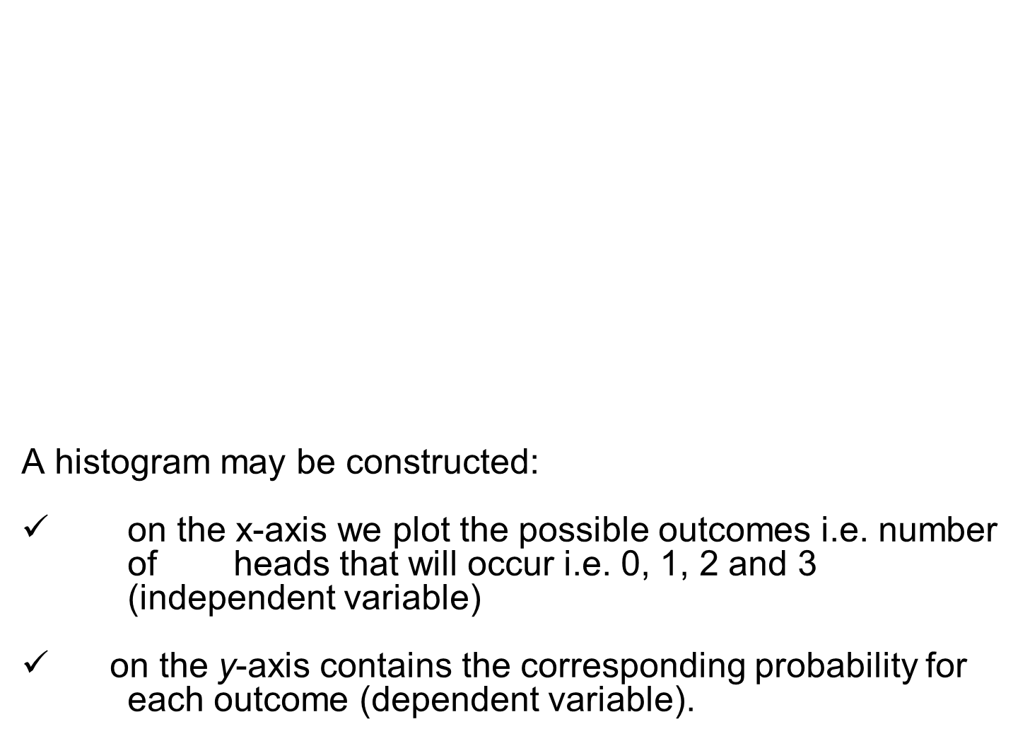
Histogram of the Probability Distribution Function

Slide 10
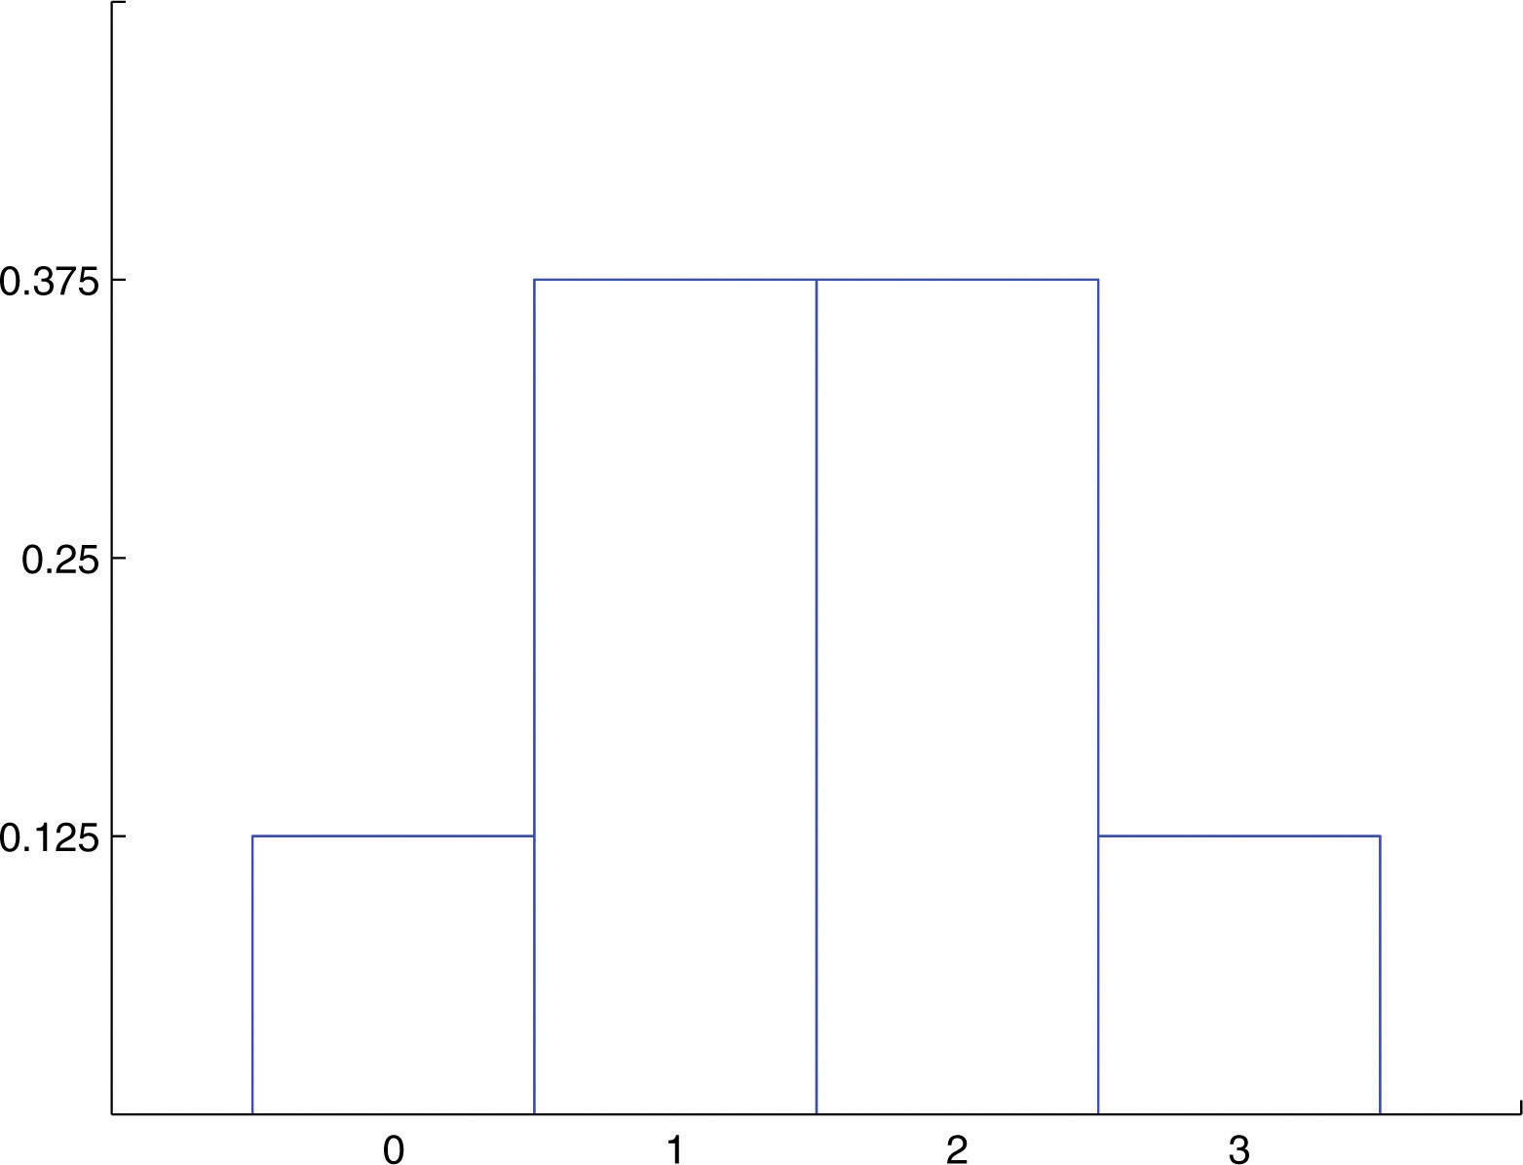
Histogram

Slide 11
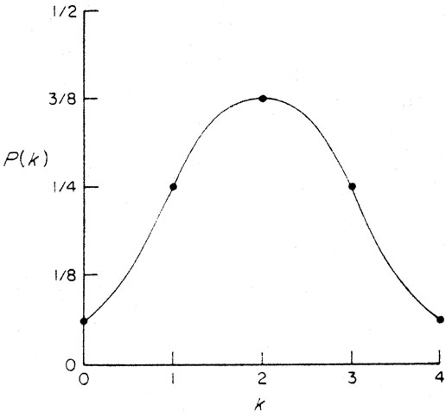
Continuous Curve

Slide 12

Statistical Measures of A Probability Distribution

Slide 13
The Mean or Expected Value
The mean also known as the expected value of a distribution is the long-run average of occurrences and is denoted by E(X) or µ_{x} or simply µ.
It is computed as follows:
µ = E(X) = ∑ x p(X=x)
Or simply:
µ = E(X) = ∑ x p( x)

Slide 14
Example 1
Compute the mean or expected value of the distribution obtained by tossing a fair coin three times, given the probability distribution below:
x | 0 | 1 | 2 | 3
p(x) | 1/8 | 3/8 | 3/8 | 1/8

Slide 15
Solution
µ = E(X) = ∑ x p( x)
µ = 0 + 3/8 + 6/8 + 3/8 = 12/8 = 1.5 heads
This means in the long run, the mean or expected number of heads when a fair coin is tossed three times is 1.5 heads. Of course, we can never have 1.5 heads.
x | 0 | 1 | 2 | 3
p(x) | 1/8 | 3/8 | 3/8 | 1/8
x. p(x) | 0 | 3/8 | 6/8 | 3/8

Slide 16
Variance and Standard Deviation
The variance of a discrete distribution be computed using the following formula:
Var (X) = σ² = ∑ x² p(x) - µ²
or Var (X) = σ² = ∑ (x - µ) ² p(x)
The standard deviation is then computed by taking the square root of the variance.

Slide 17
Example 2
Compute the variance and standard deviation of the distribution obtained by tossing a fair coin three times, given the probability distribution below:
x | 0 | 1 | 2 | 3
p(x) | 1/8 | 3/8 | 3/8 | 1/8

Slide 18
Solution
σ² = ∑ x² p(x) - µ²
σ² = (0 + 3/8 + 12/8 + 9/8) – 1.5²
= 3 - 1.5²
= 0.75
Standard deviation σ = √(0.75) = 0.87 heads
x | 0 | 1 | 2 | 3
p(x) | 1/8 | 3/8 | 3/8 | 1/8
x². p(x) | 0 | 3/8 | 12/8 | 9/8

